Slide 1


Micro-Credential
Strategic Human Resource Management
(GHRM5113)
DR MOHD FAIZAL BIN MOHD ARIF

Slide 2
Course Synopsis
This course is meant to introduce the students to the strategic perspectives, issues and challenges of human resource management. It will essentially follow an integrative approach, which will link human resources management with the overall business strategy in organisations.
The course provides a research-focused/ evidence-based appraisal of the topic according to the following key themes:
the strategic role of HR in the organisation;
the role of the HR function/ HR professional in strategic HRM;
designing and aligning HR systems for high performance;
linking HR practices to performance;
the role of employees who are at the ‘receiving end’ of these HR practices;
a critical overview of SHRM research.
The course examines the nature of HR strategies, systems and practices and the theories underpinning the creation of HR systems that may lead to high performance. It also evaluates the strategic importance of the HR practices that comprise these systems in engaging employees.

Slide 3
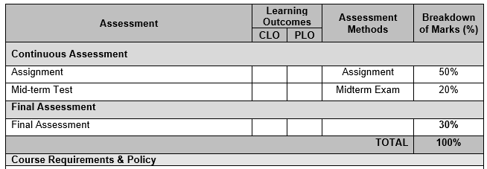
Course Assessment Details

Slide 4

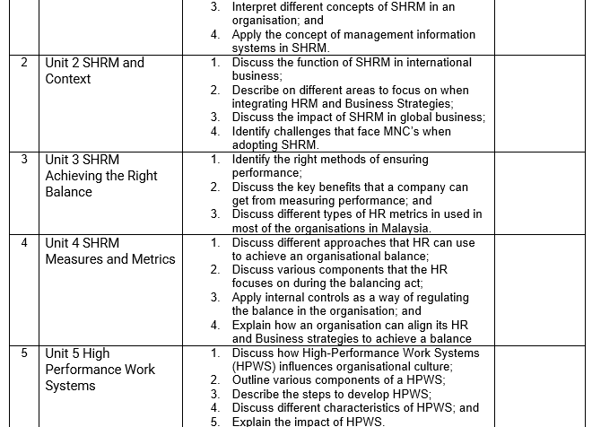
Course Syllabus

Slide 5
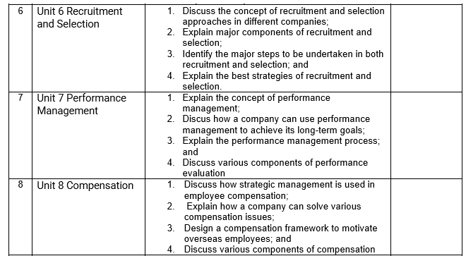
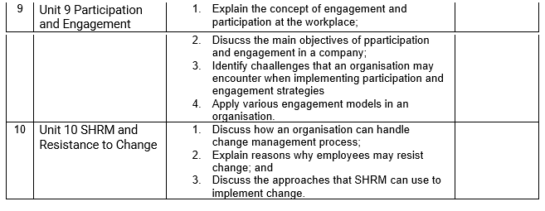

Slide 6
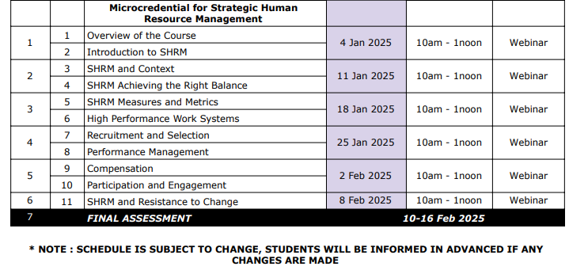

Slide 7
Format Of The Paper
A cover page with your details – Name, Student ID and the name of the lecturer.
● Font – Font Style: Times New Roman, Font Size: 12, Line Spacing: 2.0 and Paragraph: Justify
● APA format quotes for both in-text citation and reference list.
● Include a reference page for every assignment submitted.
Students should not copy from one another/copy from textbooks or the Internet in doing their assigned work. Students who are caught doing so will be penalized and the assignment rejected. PLAGIARISM is a serious offence.

Slide 8
Mid Term Test
Each student is required to sit for the mid-term test which includes multiple-choice questions, structured type of questions, and/or discussion type of questions.
The test must be taken on the specified date. If the students encounter any problem to take the tests on the specific date, they are required to inform the lecturer within 24 hours after the specified date and time. Otherwise, their right to take the tests is forfeited.

Slide 9
Final Assessment
The final assessment is comprehensive will covering topics that have been taught in class, online uploads of learning materials, as well as students’ initiatives in understanding the topics from other sources (books, media).
Students will be examined on their level of understanding and knowledge acquired in this course. The format of the examinations will include an essay and/or discussion type of questions.

Slide 10
Final Examination
The coverage, format, level of assessment and other related matters for the test and final exam will be informed by the course leader a few weeks before the assessment is conducted

